Slide 1

ML-Based Fetal Health Monitoring and Prediction
Team members
Pasupuleti Lakshmi Sujith - 21BCE7429
Pydisetty Sampath - 21BCE8466
Anguluri Pavani Anvitha - 21BCE7498
C Kishan Reddy - 21BCE7282
Under guidance of prof. M S JAGADEESH

Slide 2
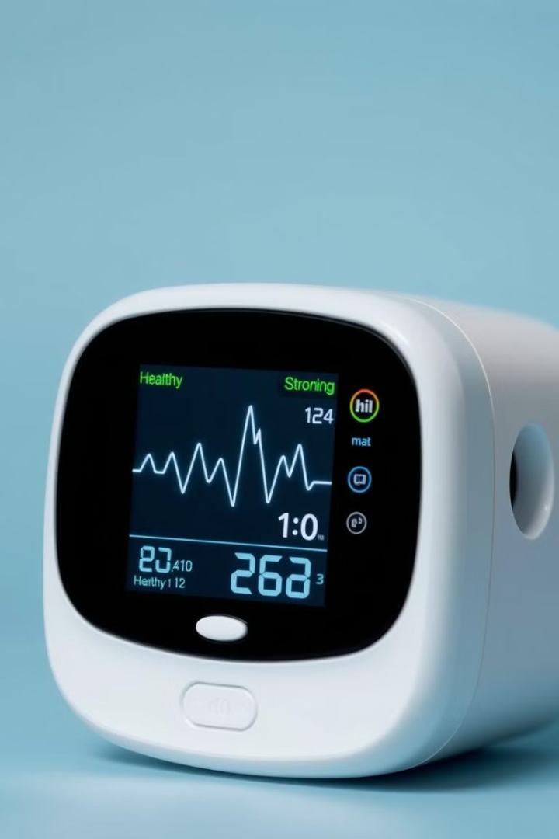
Introduction
Fetal health monitoring is essential for identifying potential complications during pregnancy. Our system utilizes advanced technology and machine learning algorithms to provide real-time insights into fetal well-being.

Slide 3

Motivation
Early detection of fetal distress can lead to timely interventions, improving outcomes for both mother and child.
Our goal is to empower healthcare providers with the tools they need to make informed decisions and ensure safe pregnancies.
To provide medical professionals with more accurate and timely information to make informed decisions during pregnancy.

Slide 4



Objective
Develop Machine Learning Models
To create robust machine learning models capable of accurately analyzing fetal data and predicting potential risks.
1
Implement a User-Friendly Interface
2
To design an intuitive and user-friendly interface for healthcare professionals to easily access and interpret the system's insights.
Validate the System's Performance
3
To rigorously test and validate the system's performance against real-world data, ensuring its accuracy and reliability

Slide 5

Problem Survey
1
Incomplete Data
2
Inconsistent Monitoring
Limited access to comprehensive fetal health data in developing countries.
Lack of continuous monitoring in remote areas or under-resourced settings.
3
Limited Predictive Accuracy
Current monitoring techniques often struggle to identify subtle signs of distress.

Slide 6
Methodology
Data collection from various sources, including hospitals and research institutions.
1
2
Preprocessing data to handle missing values, outliers, and inconsistent formatting.
Selecting appropriate machine learning models based on data characteristics and desired outcomes.
3
4
Training selected models on cleaned data to optimize predictive performance.
Evaluating model performance using various metrics, such as accuracy, precision, and recall.
5
6
Deploying the trained model to real-world settings, allowing for continuous prediction and monitoring.

Slide 7

Models Used
Gradient Boosting
Logistic Regression
An ensemble learning method that combines multiple weak learners to make accurate predictions.
A statistical model used for predicting binary outcomes, such as the presence or absence of fetal distress.
SVM
Random Forest
A powerful machine learning technique that finds the optimal hyperplane to separate data into distinct classes.
An ensemble learning technique that uses multiple decision trees to improve predictive accuracy and reduce overfitting.

Slide 8
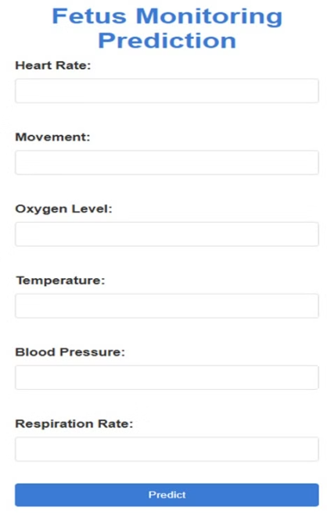
Interface
Designing a user-friendly interface that enables intuitive interaction with the deployed models.
Allowing users to input vital parameters such as heart rate, movement, oxygen levels, temperature, blood pressure, and respiration rate for predictions.
Incorporating a Predict button to initiate model processing for health status evaluation.
Displaying real-time predictions based on the entered data for better decision-making.

Slide 9





Results and Future Scopes
The machine learning models, including Gradient Boosting (98%), SVM (97.50%), Logistic Regression (97%), and Random Forest (97%), demonstrated excellent accuracy in predicting fetal health, showcasing their effectiveness for medical applications.
The models' high accuracies highlight their ability to process complex fetal health data and make reliable predictions, validating their potential for use in real-world healthcare systems.
The predictions provide valuable insights to predict critical health indicators, offering early detection of potential complications and improving maternal and fetal care. enabling early detection of potential complications for timely intervention.
wearable sensor belt could continuously monitor vital parameters like heart rate, movement, oxygen levels, and temperature, providing real-time data for accurate predictions.
Integration with cloud platforms or mobile applications would allow continuous monitoring, with instant alerts for abnormalities, enabling timely medical interventions and enhancing preventive care for both the fetus and mother.

Slide 10

Conclusion
This fetal health monitoring system has the potential to revolutionize prenatal care, ensuring the well-being of mothers and babies. Continued innovation and development will further enhance its capabilities and improve patient outcomes.

